Slide 1

Capstone Project with Spinnaker Analytics
Team A6
Kaiyu Wang, Simeng Li,
Xiangshan Mu, Yihan Jia, Yinghao Wang

Slide 2

Agenda
1
2
3
4
Introduction
EDA
Data
Process
Model Options
5
6
7
Time Series Analysis
Classification Models
Next
Steps

Slide 3

1
Introduction
Overview of our analysis

Slide 4
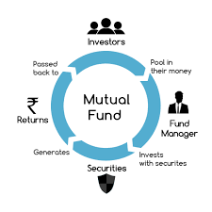
About the Dataset
The dataset contains sectoral data for 3 separate types of investments made in the US. It represents 60-70% of activity in the overall asset classes for that week. The weekly data spans 10 years from 2006 through end-Jan 2017.
Institutional Mutual Fund Holdings (IMF) - For institutional
Retail Mutual Fund Holdings (RMF) - For individual
Exchange Traded Funds (ETF) - The convenience of trading is available at any time during the day.

Slide 5
Data Fields Description
ReportDate: Weekly data aggregated and released every Wednesday
AssetClass: Industry/Sector/Asset Class
Industry: 20 industries for each type of fund (3 types of funds)
Sector: North America-USA-North America (one value for all)
Asset Class: Equity (one value for all)
Flow: Amount of positive (inflow) or negative (outflow) in Millions of USD
as the label of time series
FlowPct: Flows as percent of assets at beginning of the week
AssetsEnd: Assets at end of the week in Millions of USD
It includes factors outside the dataset that cannot be measured, so it can not be used as a label
PortfolioChangePct: Percent change in overall portfolio during the week
Notes:
1. intuitively shows dollar amount of value of a given fund
2. other attributes have factors outside the dataset that influence the value
All observations come from the same sector and asset class.

Slide 6
Project Overview
Business Objective:
find a tradable signal in the dataset
Our Tradable Signal:
Time Series Models: Use Flow as output label
Classification Models: Use self-calculated label: Recalculated Monthly Flow Change in Percentage, and put it into different range buckets.

Slide 7
Business Application:
The prediction of fund prices is of great significance in business and finance.
Fund traders, mutual funds, investors and security analysts all want a way to predict fund price fluctuations. Anticipating the fluctuations of fund prices (up or down) and tradable signals in advance can help fund traders make better investment decisions.
A good prediction model can make investors better understand the internal factors of fund price changes and provide support for better risk management.
We can also make recommendations based on long term, short term, different client needs and fund types.
Notes:
EX.if the flow is predicted to be increase and potentially reach the peak in the future 2 weeks, we can suggest clients to sell it on that time for more profits

Slide 8
2
Data Pre-process
Basic Data Cleaning and Processing

Slide 9
Data Cleaning
Concatenation
Drop useless features
Extract year and month
All the Asset and Sector values are the same, we only keep Industry
We extract year and month from date for further EDA and classification model compiling
Concat three datasets into one dataframe for further analysis,
Add one “Type” feature to recognize category
Notes:
This part we should mention:
no null value detected, no duplicated rows.
But need further eda to check whether there is discontinuity about missing records in term of report date.

Slide 10
3
EDA
Exploratory data analysis

Slide 11
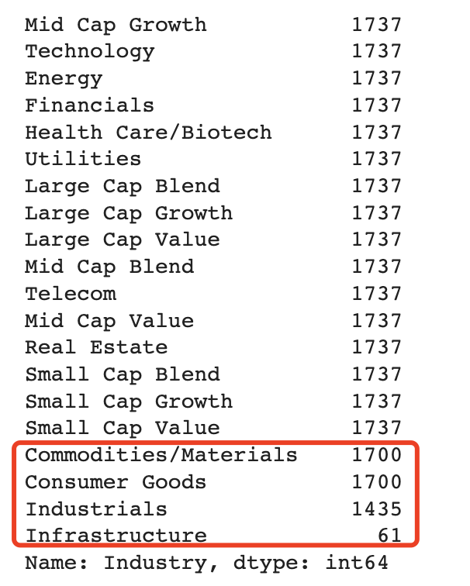
Some Industries Have Fewer Observations
There are four industries have missing observations during ten years’ recording.
We want to further analyze on these industry to understand:
Whether certain type of fund has fewer records than the others;
Where to start with missing data: at the very beginning, at the end, or discontinuity with no pattern.

Slide 12
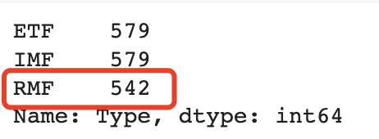
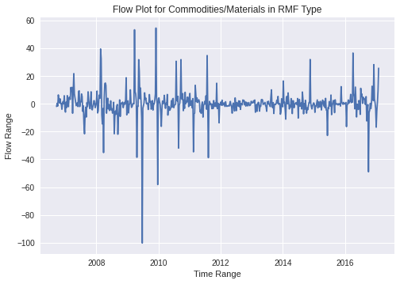
Commodities/Materials & Consumer Goods -
Beginning of RMF Records is 37 Weeks Later Than The Other Two
RMF type of fund has a later beginning than the other two:
First record is on “2006-09-20”,
While the other two is on “2006-01-04”.
Difference in weeks between first record of types match with number of missing value.
There is no other discontinuity exists

Slide 13
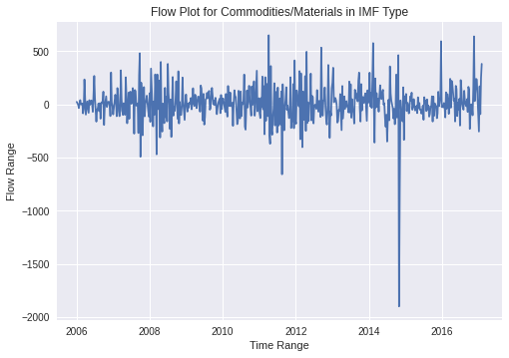

Commodities/Materials Industry -
IMF and ETF Share Similar Pattern in terms of Flow
We can observe a very similar pattern of flow rises and drops;
Not only did the changes happen at the same time, but the magnitudes of increases or decreases were roughly the same.

Slide 14
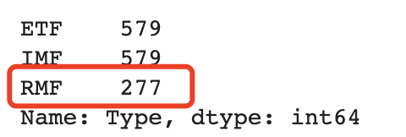
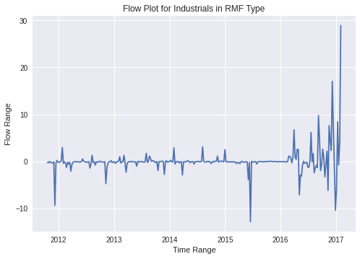
Industrials Industry -
Have only 5 years of RMF Records
RMF type of fund has a later beginning than the other two:
First record is on “2011-10-19”,
While the other two is on “2006-01-04”.
Meaning we have only about 5 years of RMF records, which is half less than ETF or IMF.
Difference in weeks between first record of types match with number of missing value.
There is no other discontinuity exists

Slide 15
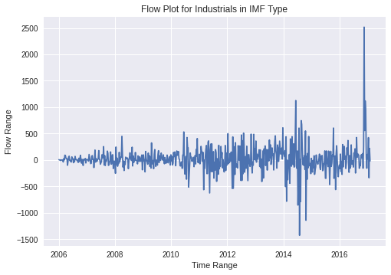

Industrials Industry -
IMF and ETF Share Similar Pattern in terms of Flow
We can observe a very similar pattern of flow rises and drops;
Not only did the changes happen at the same time, but the magnitudes of increases or decreases were roughly the same.

Slide 16
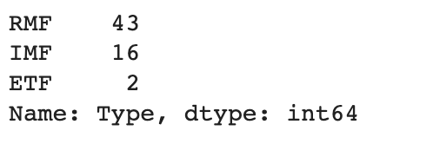
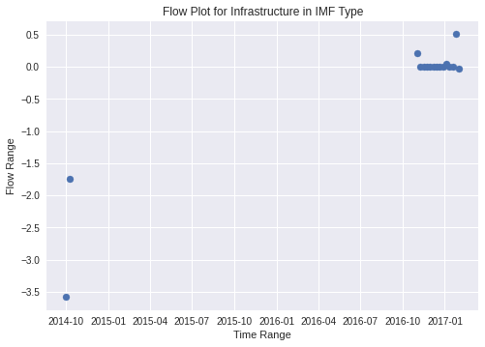
Infrastructure Industry -
Too Few Records in Each Type
Number of observations in each type is less than 1 year.
Infrastructure industry has a recent start for RMF and IMF:
RMF: the first record is on “2016-04-13”;
IMF: the first record is on “2014-10-01”.
Two records of ETF all on 2014, only for 2 weeks.
There also exists discontinuity in IMF type.
⇒ Our decision:
This industry is not considered in the subsequent
modeling of predicting tradable signals.

Slide 17
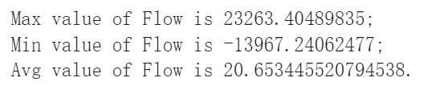
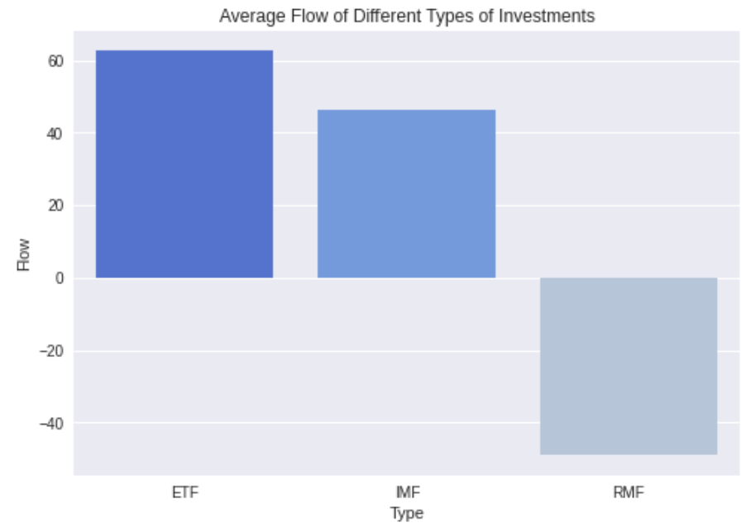
Average Flow among Different Types
ETF Funds Have the Largest Average Flow
The average flow of ETF funds is the largest.
The average flow of both ETF and IMF funds is greater than the overall average flow.

Slide 18
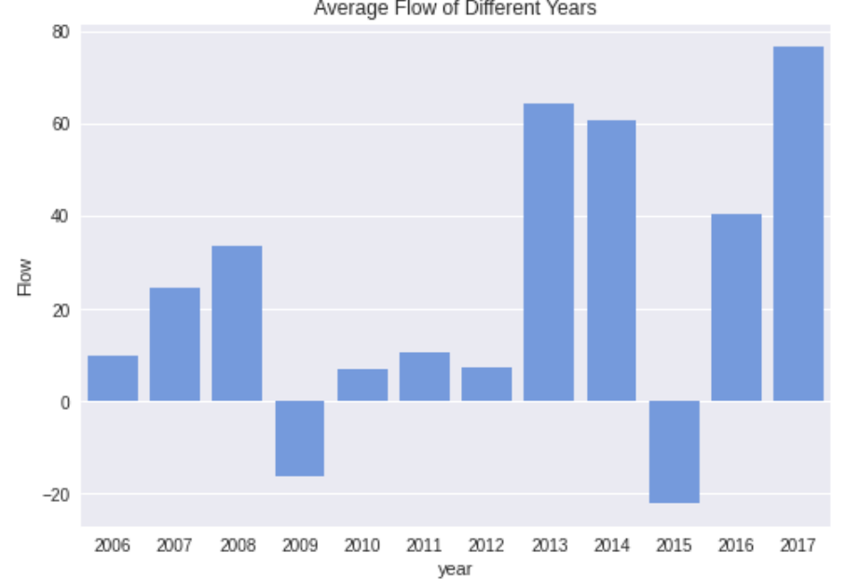
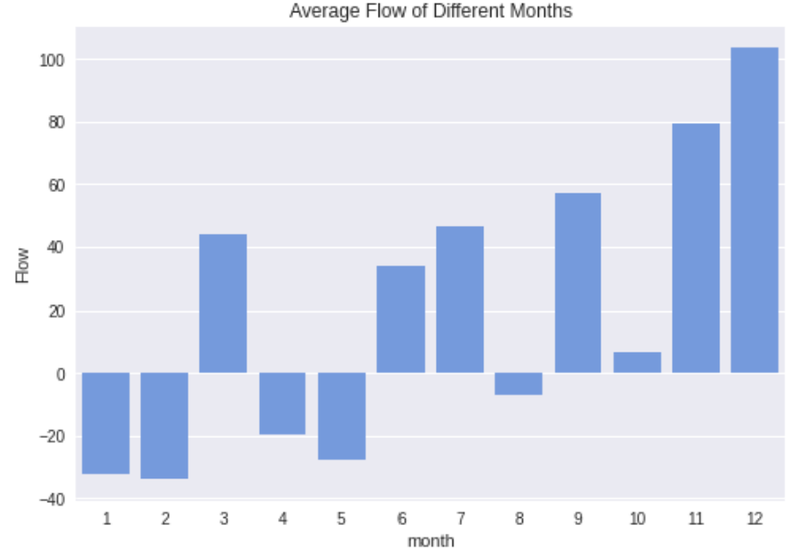
Average Flow among Different Years & Months
More Inflows in the Second Half of 2013 - 2017
Most of the positive average flow concentrated in the second half of the year.
Most of the funds flowed out in
the first half of the year and flowed in in
the second half of the year.
Average flows are very high from 2013 to 2017, except for 2015.
Average flows in 2009 and 2015 were negative and we'd guess more money was withdrawn.

Slide 19
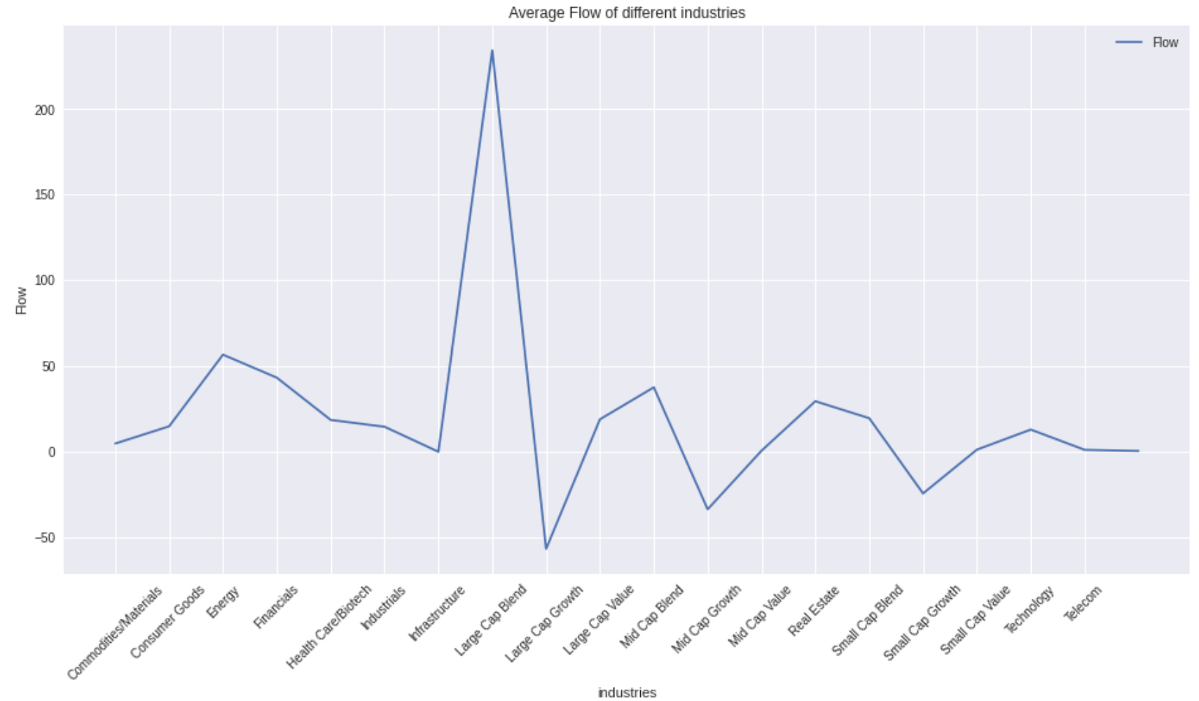
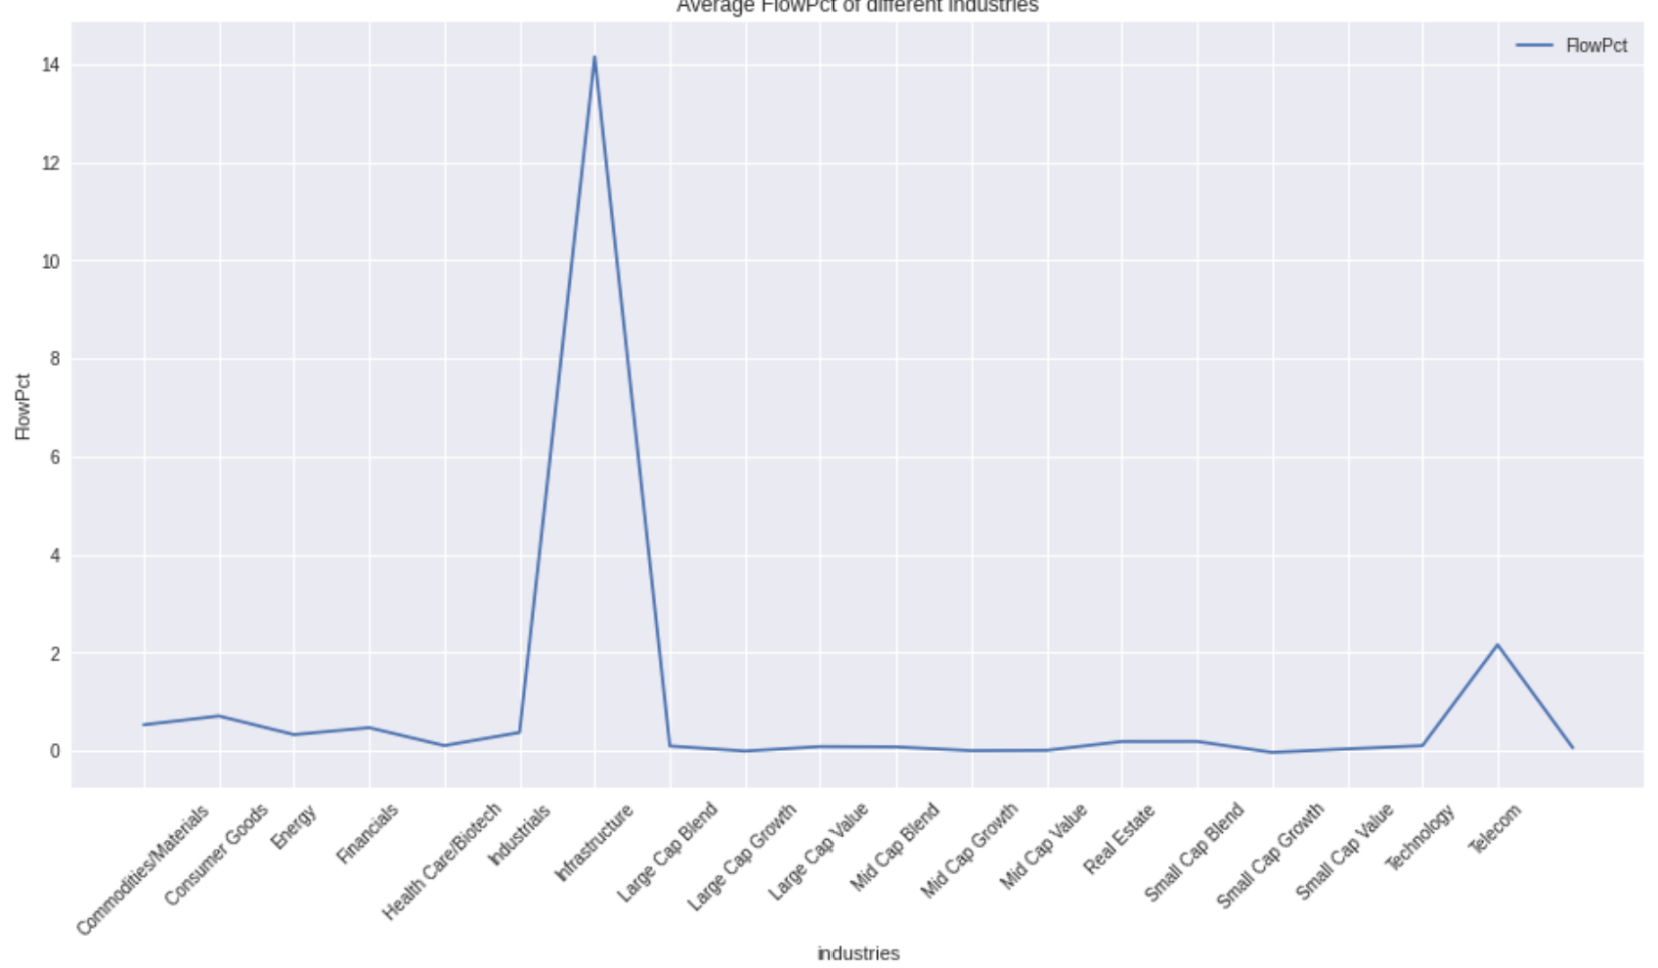
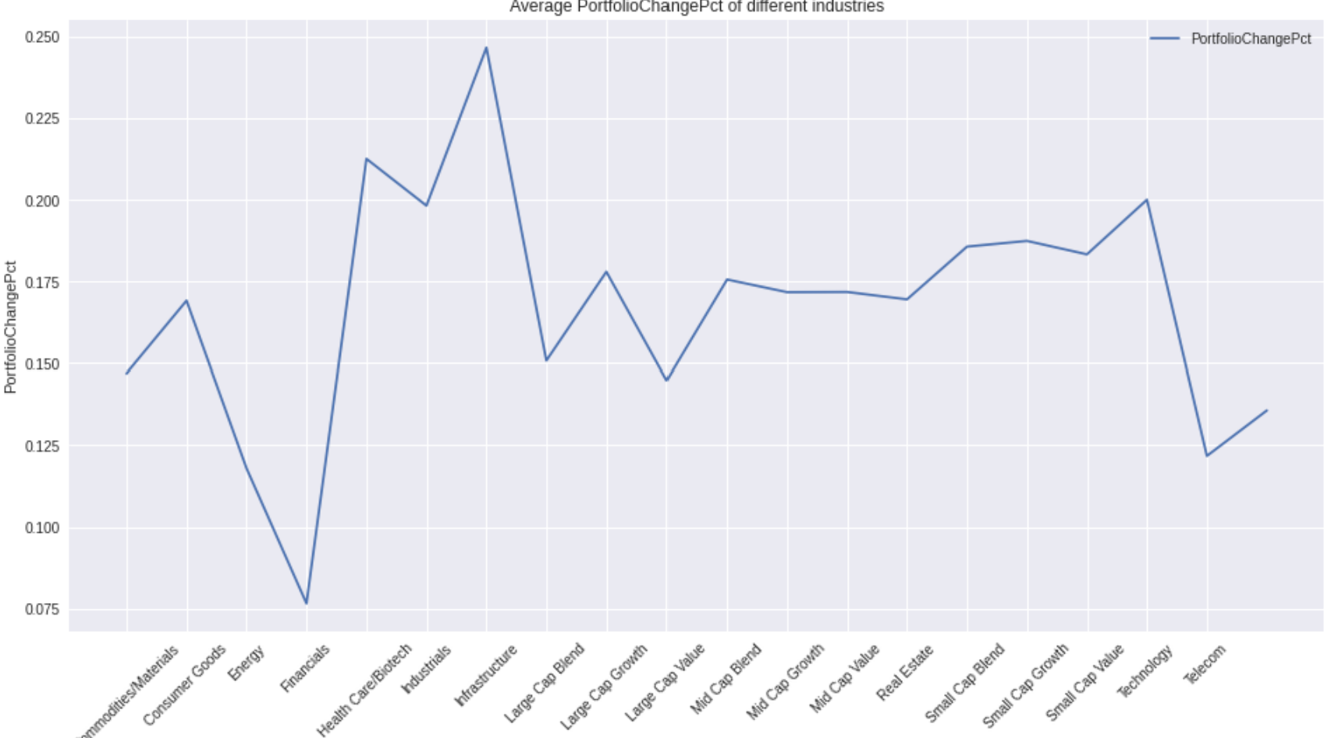
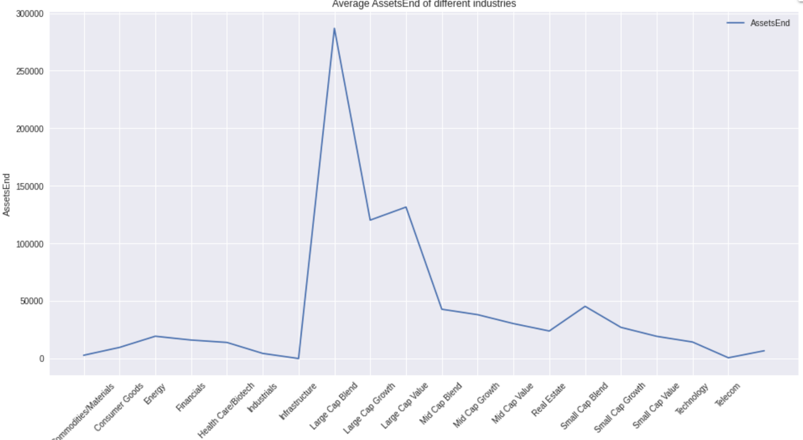
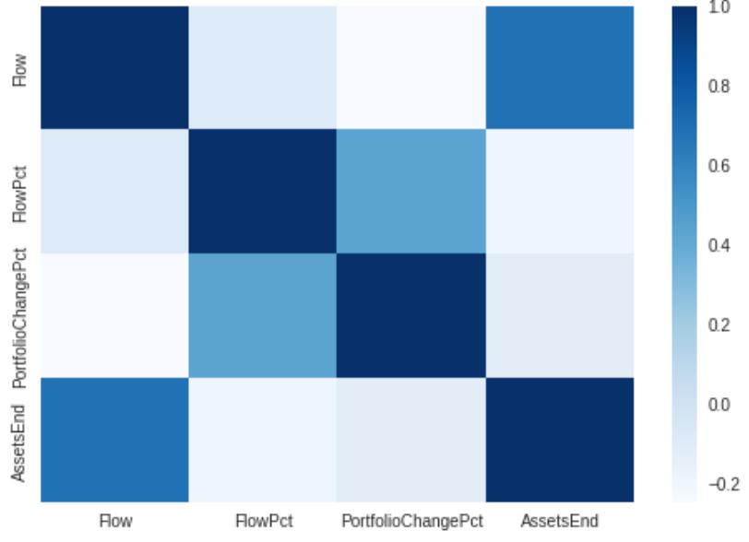
Features by Different Industries
Flow is Less Correlated with PortfolioChangePct
We can see that the correlation between Flow and AssetsEnd is large, but the correlation between Flow and PortfolioChangePct is extremely small, so then we need to observe PortfolioChangePct.
Flow
FlowPct
PortfolioChangePct
AssetsEnd

Slide 20
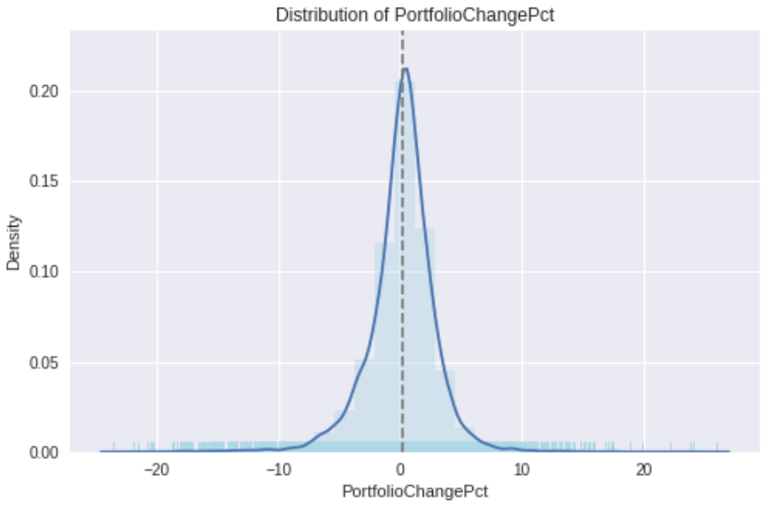
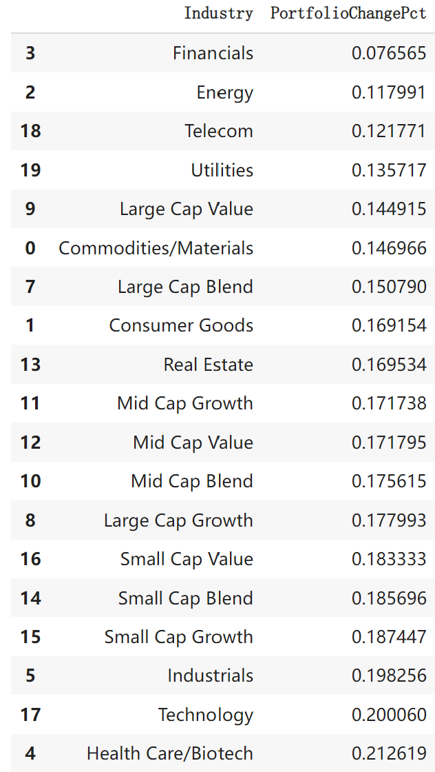
Average PortfolioChangePct among Different
Industries
Financial & Energy Have the Smallest Ones
PortfolioChangePct is normally distributed and most concentrated in the range (-10, 10).
Smallest average PortfolioChangePct:
Financial & Energy → Stable → Cautious
Largest average PortfolioChangePct:
Health Care/Biotech & Technology → Risky → Open

Slide 21
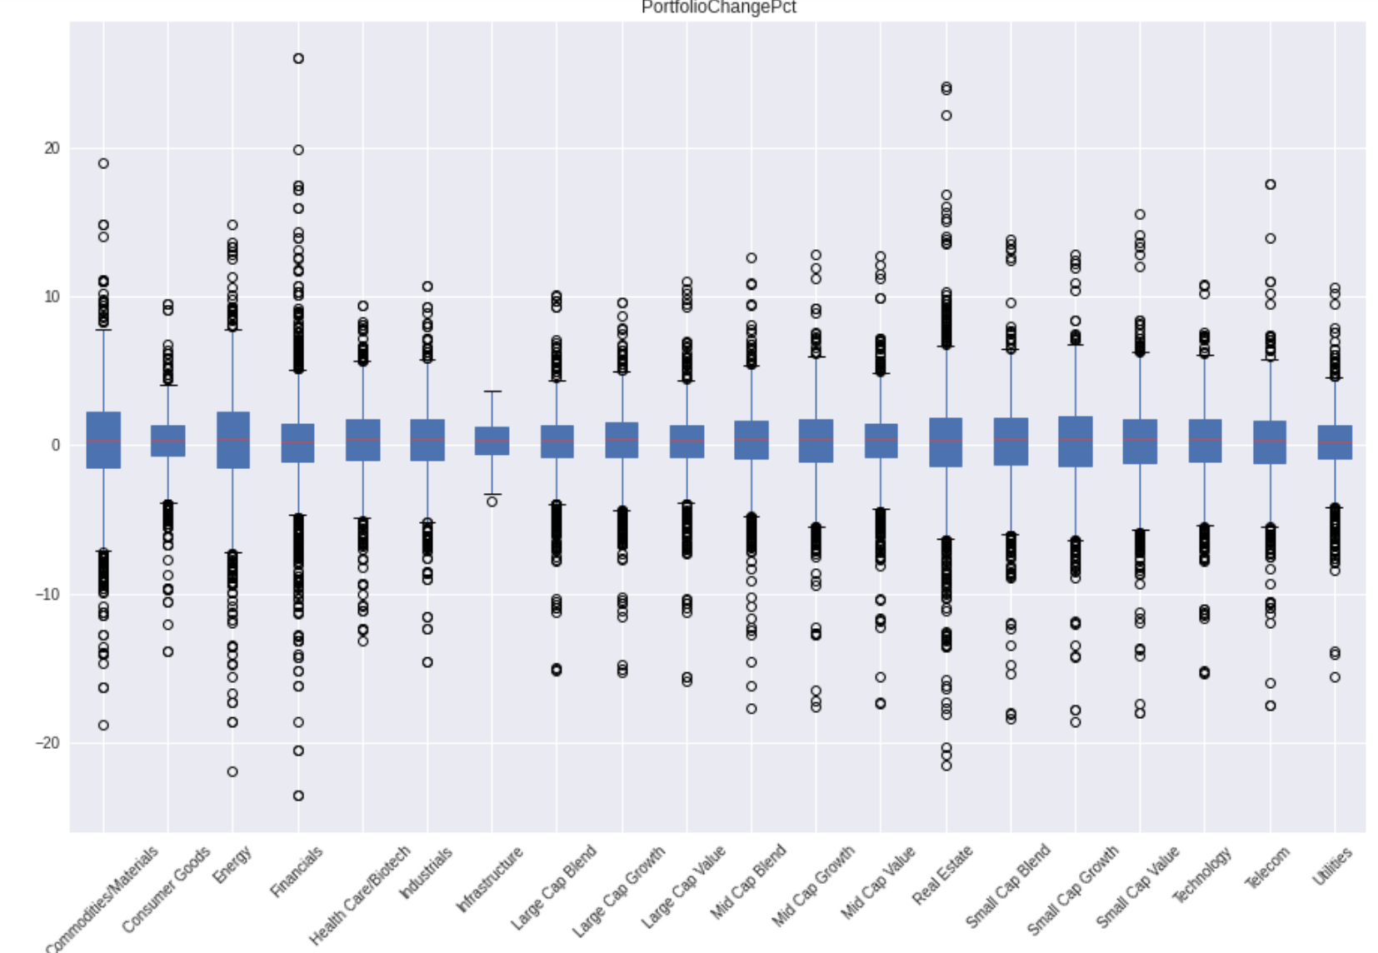
PortfolioChangePct Distribution of Different
Industries
Decentralization Means Greater Possibility of Profit, Concentration Means Avoiding Huge Losses
We focus on the 4 most representative industries：Financial, Energy, Health Care/Biotech & Technology
Financial & Energy: the volatility is small but the distribution is the largest, which makes it easy for investors to profit :)
Health Care/Biotech & Technology: The volatility is high but at the same time the distribution is small, which means that even a drop will not bring huge losses :)

Slide 22
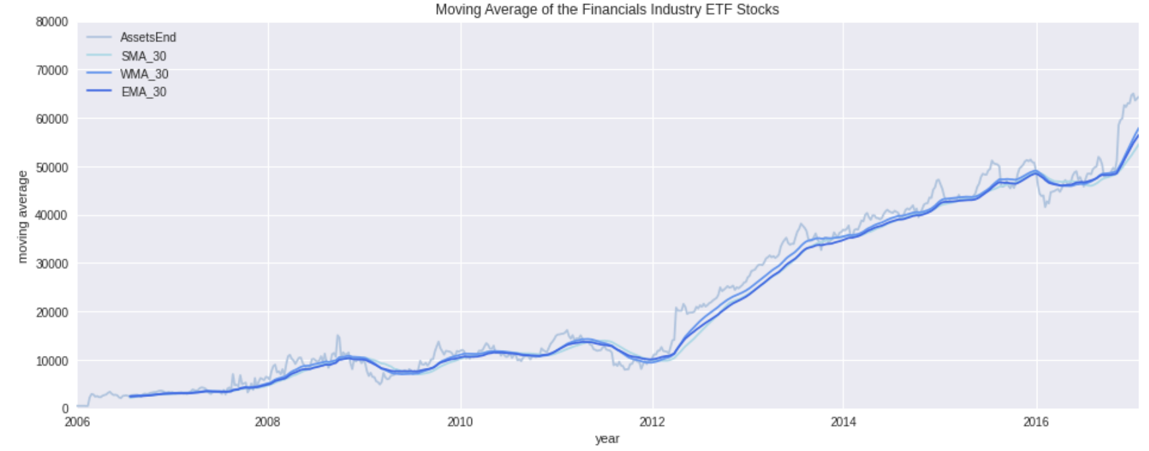
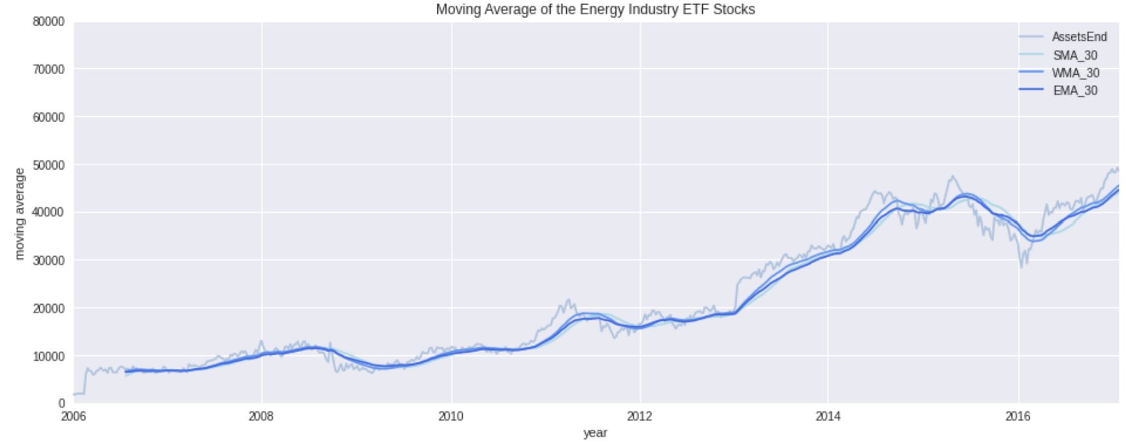
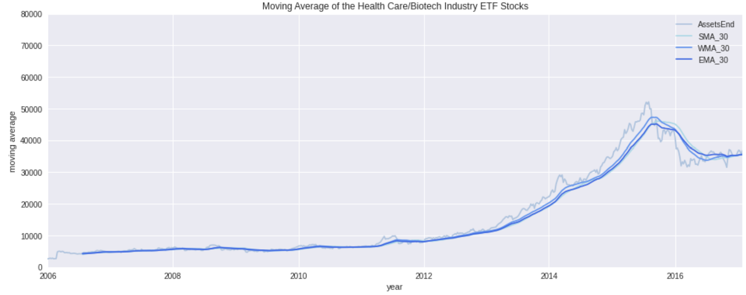
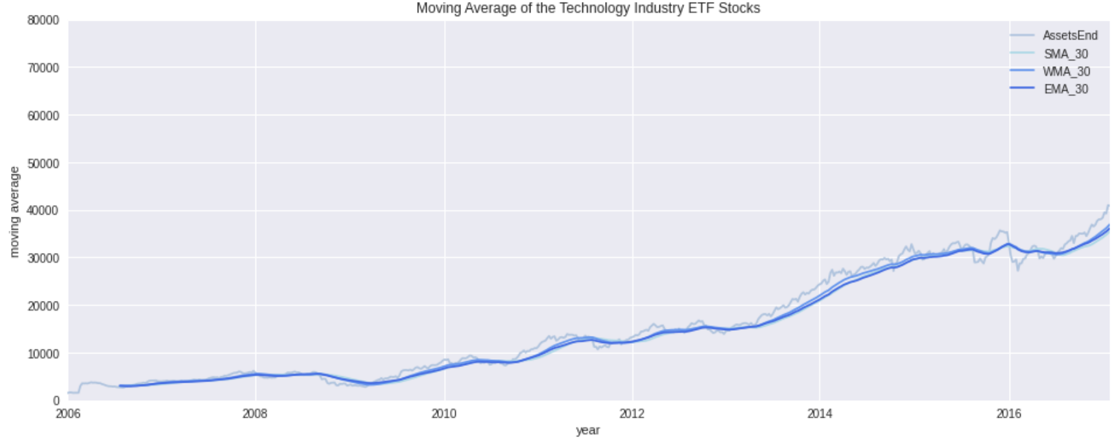
Moving Average of ETF Type
Smoothing Fluctuations for Time Series Forecasting
Financial
Energy
The chart below shows AssetsEnd data for 4 industry ETF funds along with a 30-week simple moving average.
Moving averages smooth out volatility, thus showing long-term volatility trends.
Health Care/Biotech
Technology
Technology

Slide 23
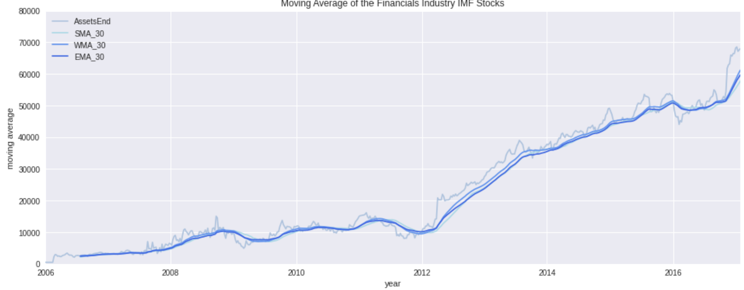
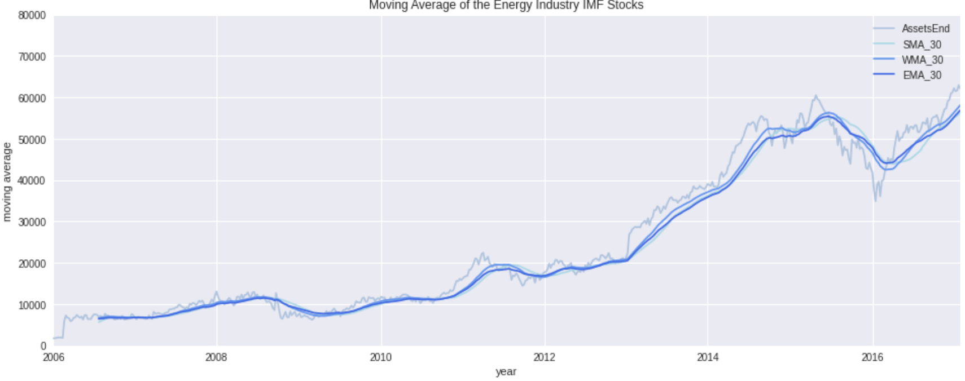
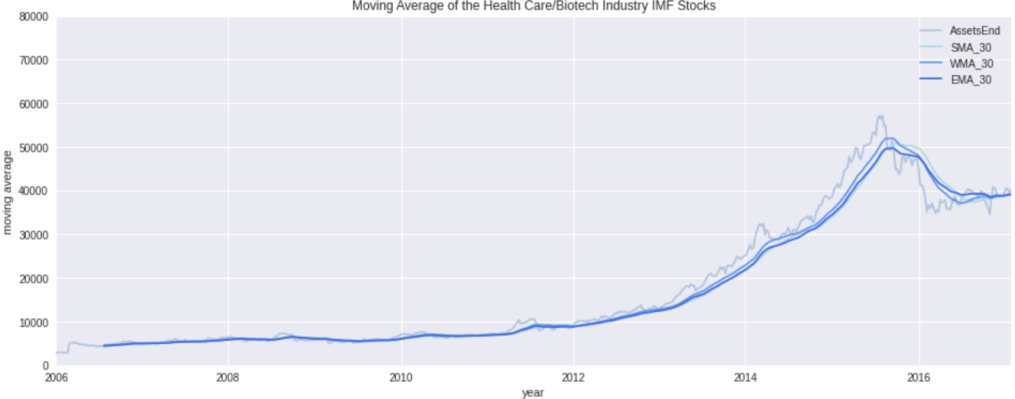
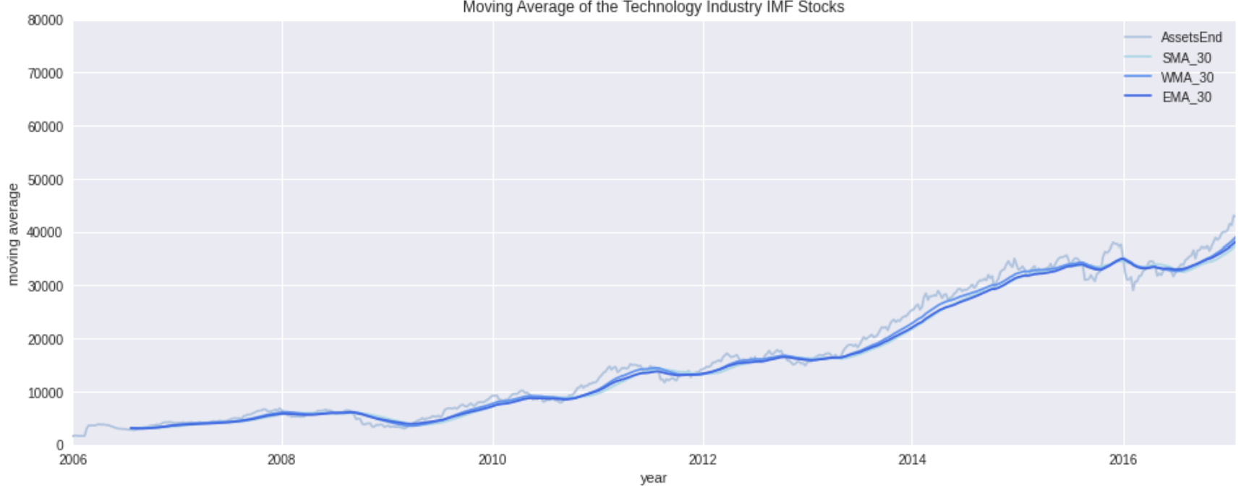
Moving Average of IMF Type
Volatility is a Little Bit Larger than that of ETF
Financial
Energy
In general, the trend is almost the same as that of ETF funds AssetsEnd, but all the volatility is a little bit larger than that of ETF.
Health Care/Biotech
Technology

Slide 24
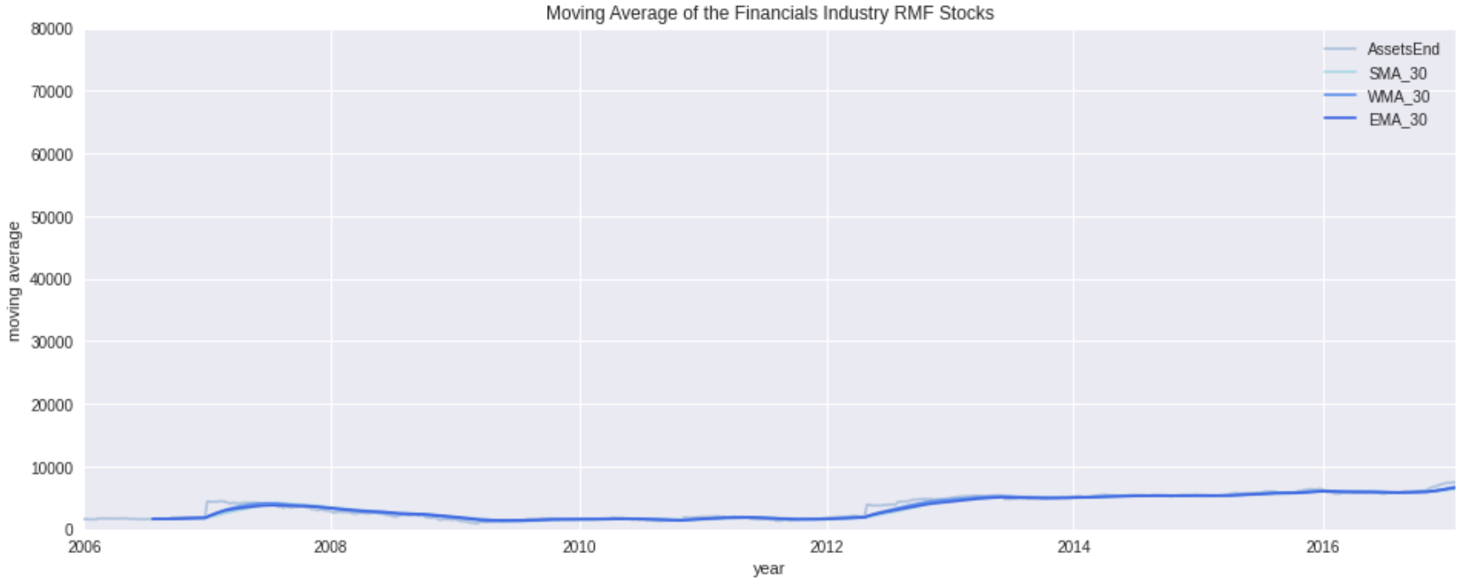
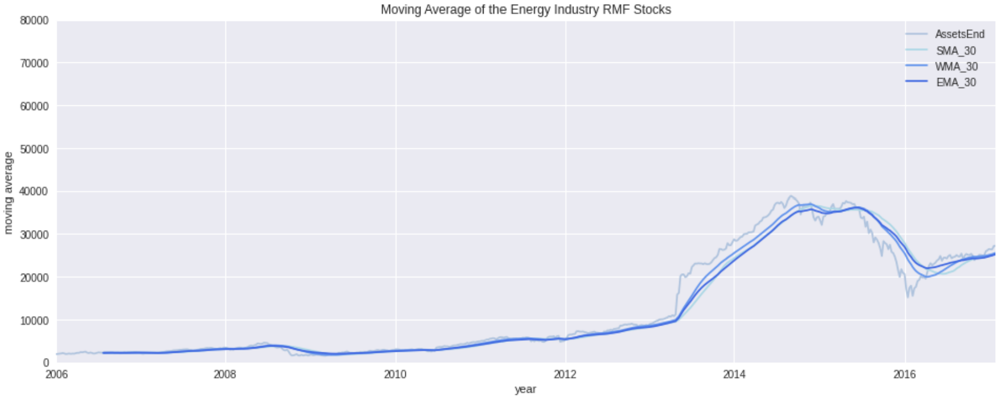
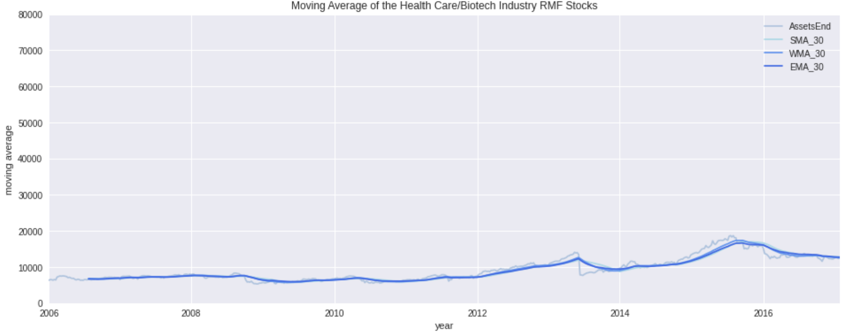
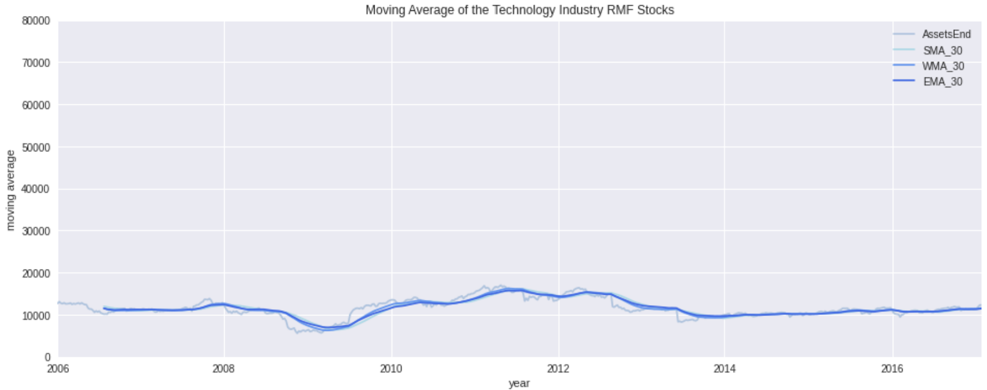
Moving Average of RMF Type
RMF-type Funds Have the Smallest and Smoothes Values
Financial
Energy
Overall, RMF-type funds have the smallest and smoothest AssetsEnd values, and from an forecasting perspective, energy companies have the highest values of AssetsEnd.
Health Care/Biotech
Technology

Slide 25
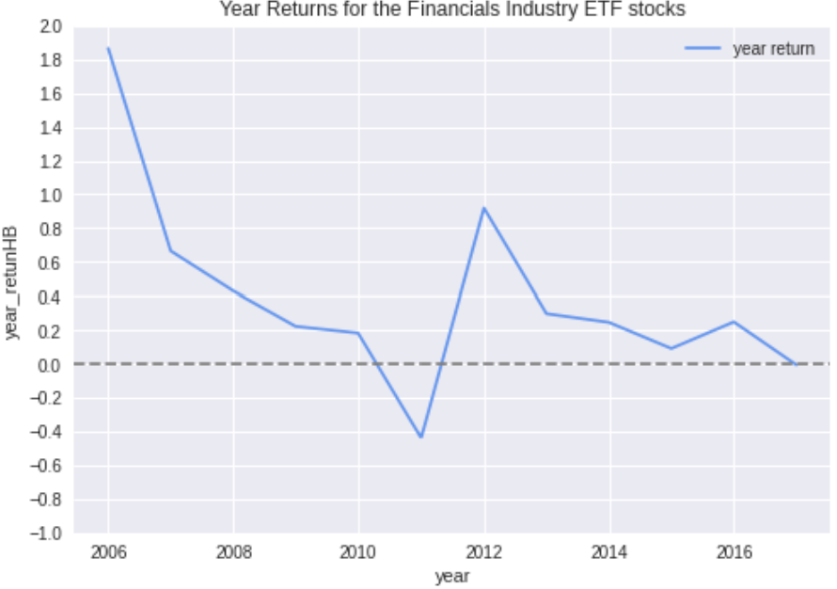
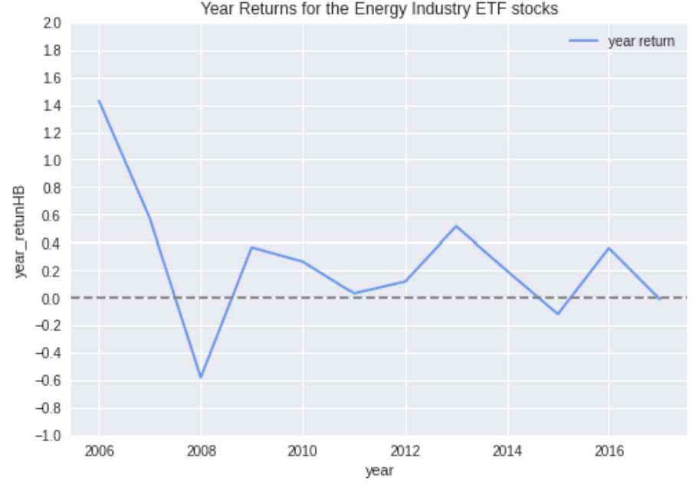
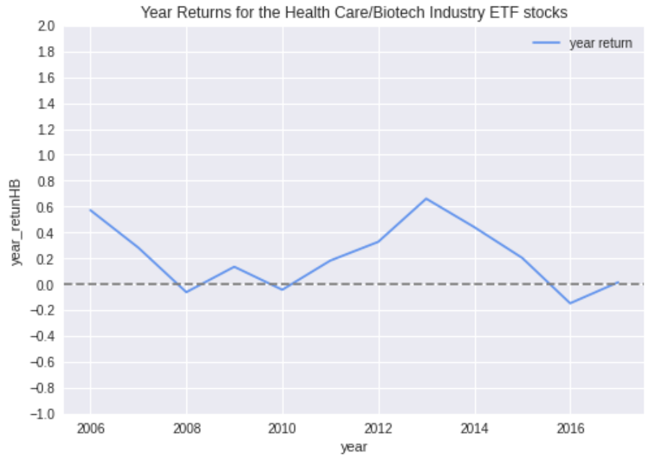
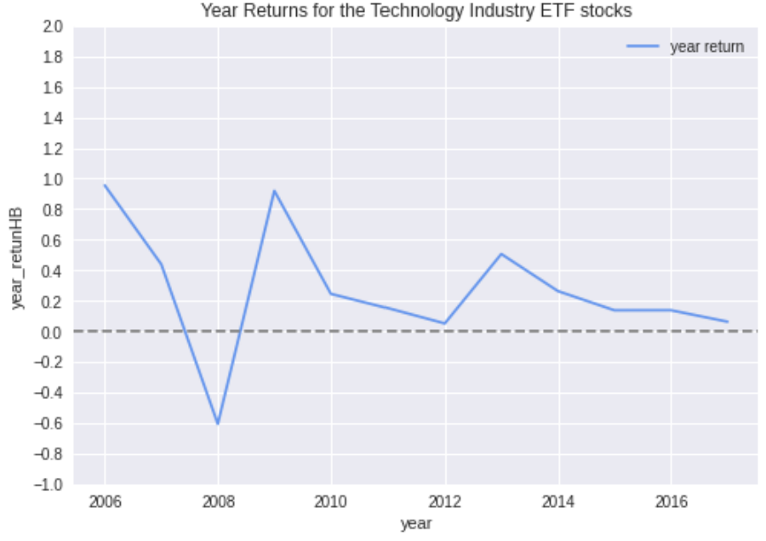
Fund Year Returns on ETF Type
Only the Health Care/Biotech Industry Shows an Increasing Trend
Financial
Energy
The Health Care/Biotech industry has the most stable annual returns.
Both 2013 and 2016 saw peak annual returns except for the Health Care/Biotech industry.
From the recent trend observation, only the annual rate of return of the Health Care/Biotech industry shows an increasing trend.
Health Care/Biotech
Technology

Slide 26
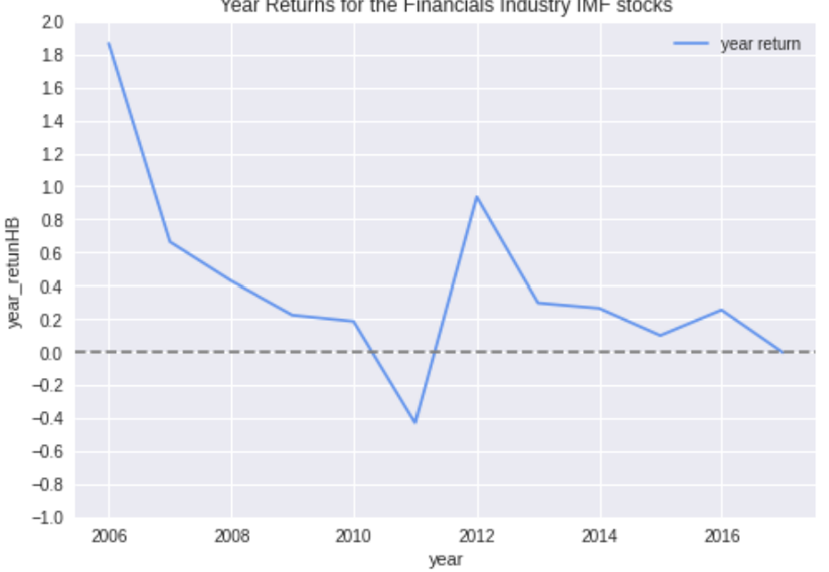
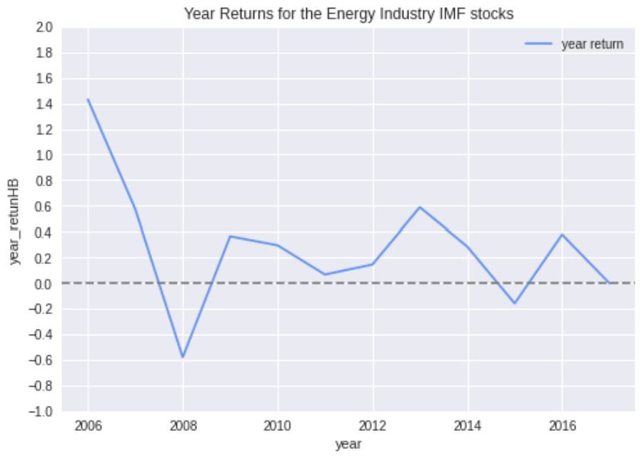
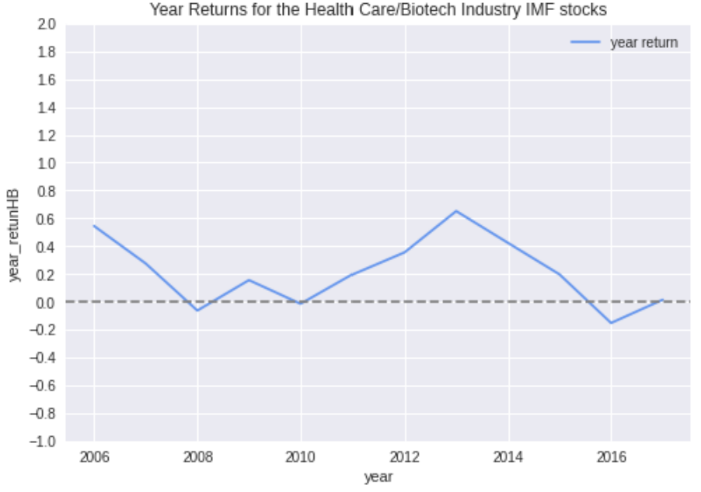
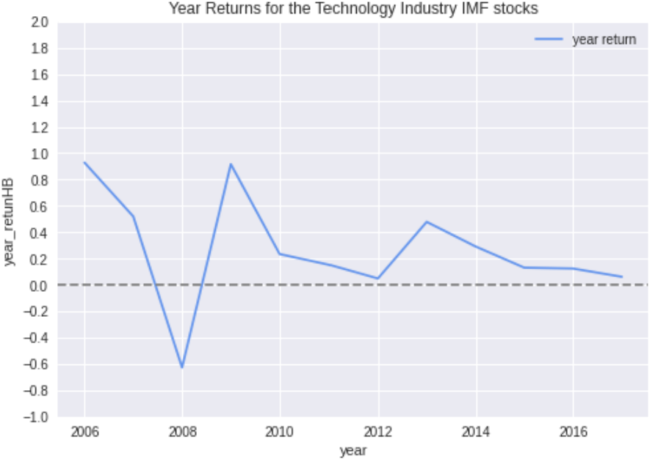
Fund Year Returns on IMF Type
No Big Difference Compare with the ETF Type
Financial
Energy
It seems that there is no big difference between IMF fund annual returns and ETF returns.
Health Care/Biotech
Technology

Slide 27
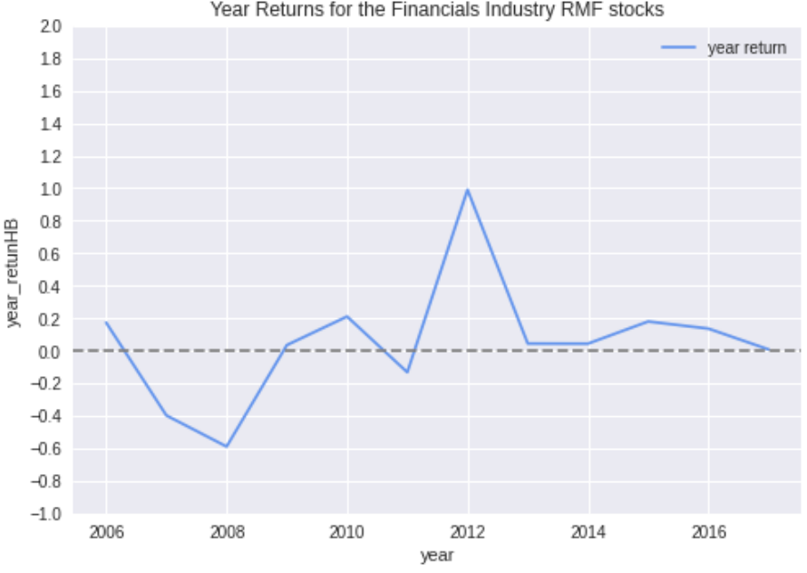
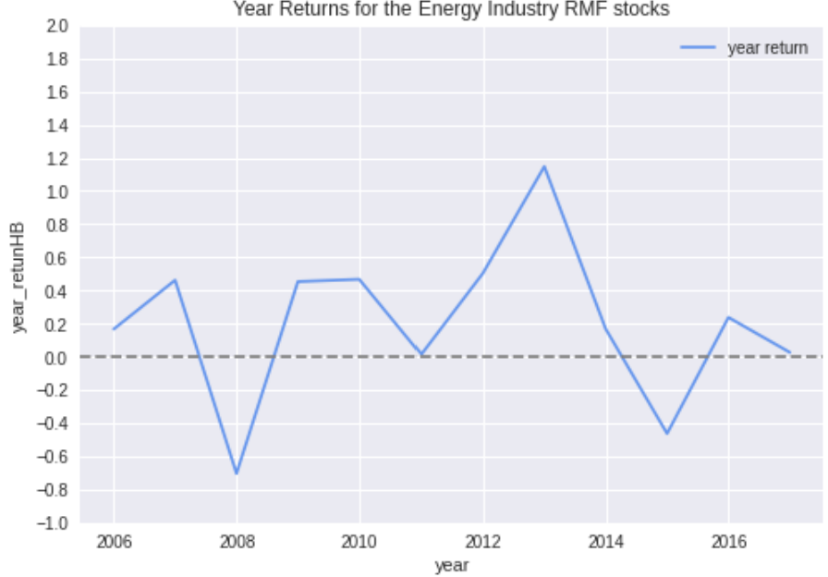
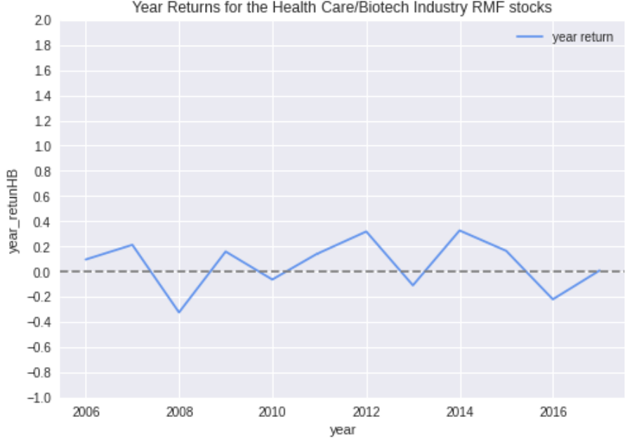
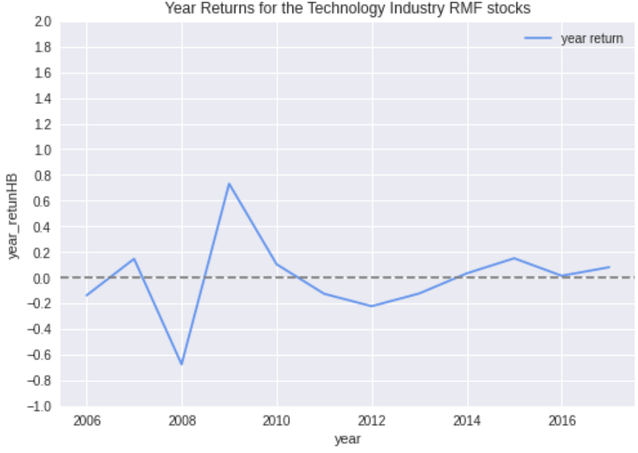
Fund Year Returns on RMF Type
Health Care/Biotech and Technology Industries Show an Upward Trend
Financial
Energy
The annual returns of RMF funds in the Financial and Energy industries are more volatile and show a downward trend in recent years.
The annual returns of RMF funds in the Health Care/Biotech and Technology industries have shown an upward trend.
Health Care/Biotech
Technology

Slide 28
Exploratory Data Analysis - Findings & Conclusion
Flow is highly correlated with AssetsEnd and Less correlated with PortfolioChangePct;
More inflows in the second half of 2013 - 2017;
Financial & Energy: stable, easier to profit but the annual rate of return shows a downward trend↓ [Cautious investors];
Health Care/Biotech & Technology: risky, avoid huge losses, the annual rate of return↑ [Open investors];
AssetsEnd of IMF funds and ETF funds move almost the same, but the IMF is more volatile; There is no big difference between IMF fund annual returns and ETF returns;
RMF-type funds have the smallest and smoothest AssetsEnd values;
Funds in the same industry tend to have the similar trend and range in terms of Flow for IMF and ETF type;
Infrastructure of RMF type fund could probably be delisted (no need to forecast), while for the other two types we have a limited number of observations for model fitting.

Slide 29
4
Model Options
Hypothesis & solution formulation

Slide 30
Model Options
We can predict the tradable signal in two ways:
Prediction by time series regression to predict what the act.
But it has limitations. Time series regression can only give rough predictions within a given time.
Hypothesis test: (stationarity test)
h0: non-stationary, ha: stationary
Models: MA, Exponential Smoothing, ARIMA, LSTM
By using Multi-Class Classification Models to predict what is the range of the flow’s changes.
Models: KNN, LogisticRegression, RandomForest, Decision Tree, GBDT, AdaBoost, GaussianNB, LinearDiscriminantAnalysis, QuadraticDiscriminantAnalysis, SVM

Slide 31
We will do it step by step!
Global Optimization
Moderate Approach
Local Optimization
Compile a model that works for all sub-categories
Find similarities that exist between sub-categories, and generate model for groups
Separate for each: for each unique combination of industry and fund type

Slide 32
5
Time Series Analysis
Studying the Characteristics of Flow wrt ReportDate
Notes:
studying the characteristics of the response variable with respect to time

Slide 33
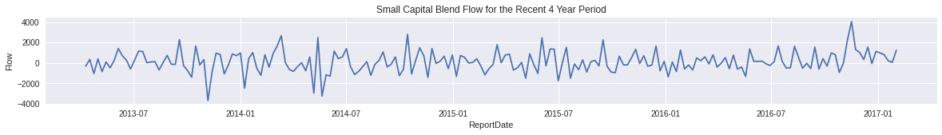
Time Series Analysis - Basic Properties
Trend:
Refers to a long-term increase or decrease in the time-series data
Can be a roughly slope going through the data
Seasonality:
Refers to periodic fluctuations.
If there exists repeated pattern, we can intuitively observe the length of the interval from the line chart of flow by time.
Cyclicity:
Refers to (regular or periodic) fluctuations around the trend, excluding the irregular component, revealing a succession of phases of expansion and contraction.

Slide 34
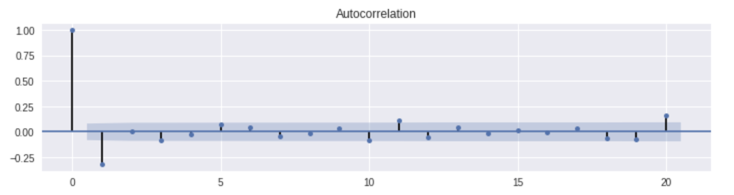
Time Series Analysis -
Relationship between current value and past
Autocorrelation:
Refers to the similarity between observations as a function of the time lag between them.
We can also derive the inference about seasonality from autocorrelation plots.
1 spike outside the blue region, meaning that there is correlation at lag 1.
Difficult to identify a seasonality, because increases and decreases are not showing a clear pattern of same interval.
Notes:
An autocorrelation (ACF) plot represents the autocorrelation of the series with lags of itself.
A partial autocorrelation (PACF) plot represents the amount of correlation between a series and a lag of itself that is not explained by correlations at all lower-order lags.
Ideally, we want no correlation between the series and lags of itself. Graphically speaking, we would like all the spikes to fall in the blue region.
https://towardsdatascience.com/time-series-in-python-exponential-smoothing-and-arima-processes-2c67f2a52788
As we can see, there are several spikes above the blue region, meaning there are correlations at lags 1, 2, 3 and 4.

Slide 35
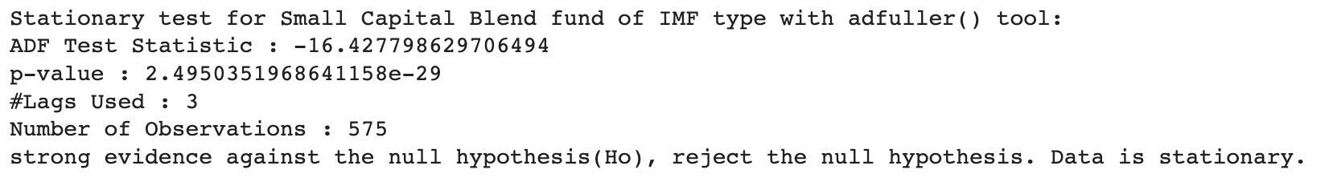
Time Series Analysis - The Golden Rule
Stationarity:
Check whether statistical properties such as mean, variance, and covariance do not vary with time.
Why Important: stationarity is the pre-requirement of a time-series data continuing to “inertia” along the existing form in a further period, thus, it is the precondition for predictable.
Before fitting each model, we have to conduct a stationary test.

Slide 36
Time Series Analysis - Models From Simple to Complex
Moving Average:
States that the next observation is the mean of all past observations.
A smoothed flow line with highlighted different trends.
Exponential Smoothing:
Different weights are assigned to different observations: the more recent, the more important,
ARIMA:
AR: Autoregression. A model that uses the dependent relationship between an observation and some number of lagged observations.
I: Integrated. The use of differencing of raw observations (e.g. subtracting an
observation from an observation at the previous time step) in order to
make the time series stationary.
MA: Moving Average. A model that uses the dependency between an
observation and a residual error from a moving average model applied to
lagged observations.
Notes:
a different decreasing weight is assigned to each observations. In other words, less importance is given to observations as we move further from the present.

Slide 37
Time Series Analysis - Models From Simple to Complex Cont.
4. LSTM
Long Short Term Memory networks – usually just called “LSTMs” – are a special kind of RNN, capable of learning long-term dependencies.
Applications:
Speech Recognition (Input is audio and output is text)
Machine Translation (Input is text and output is also text)
Image Captioning (Input is image and output is text)
Sentiment Analysis (Input is text and output is rating)
Music Generation/Synthesis ( input music notes and output is music)
Video Activity Recognition (input is video and output is type of activity)
Time-Series Prediction
LSTMs can be used where ever there is time dependent information.
(To be precise wherever there is sequence data)

Slide 38
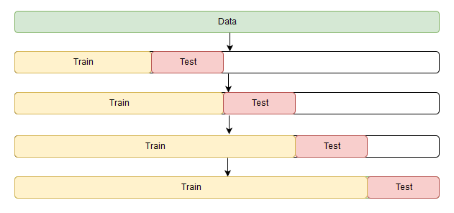
Time Series Analysis - General Design for All Models
Model Inputs/Predictors:
Past time-series data (ReportDate & Flow)
Target Variable:
Flow in the future
Validation Method:
Train test split
Forward Chaining
Evaluation Metrics:
Visually: smoothness of the flow
Mathematically: accuracy, MAE
Forward Chaining Schematic Diagram

Slide 39

Moving Average - MA(q) model
“Window” selection - q:
Intuitive choices:
simple start with MA(1),
monthly average flow (MA4),
quarterly average flow (MA12)
Based on ACF plot:
Select lag index when coefficients begin to be not significant

Slide 40

Exponential Smoothing
Smoothing level factor - α:
Ranges from 0 ~ 1
0: only the most recent values influence the forecast results
1: past observations generate a larger influence on forecast results
Curve is smoother, and the predictions are more accurate in term of a lowe MSE.

Slide 41


AutoRegressive Integrated Moving Average -
ARIMA Model
Lag Order - p:
Based on previous ACF plot, we choose 1
Degree of Differencing - d:
Usually equals to 1
Window - q:
Limitations on invertibility, we start with 0.
Performance Metrics:
AIC & BIC, the lower the better.
Our ARIMA(1,1,0)’s performance is not satisfactory and need further improvement (considering seasonality factor and change model order);
Compared with the actual Ys, the predictions make the up & downs in advance.

Slide 42

Long Short-Term Memory -
LSTM Model
Can be applied to specific industry
405-174 split（70%-30%）
Follow most of jump and down
With some lag

Slide 43
Performance Evaluation -
2 Year Forecasting on Small Blend Capital of IMF Type
Model | MAE | MSE | AIC | BIC
MA(4) | 624.26 | 651186.81
ES(alpha = 0.3) | 545.00 | 502845.12
ES(alpha = 0.5) | 426.82 | 293991.73
ARIMA(1, 1, 0) | 907.98 | 1333909.03 | 10191.546 | 10204.624
ARIMA(0, 1, 1) | 729.74 | 912056.07 | 9918.990 | 9932.069

Slide 44
Time Series Forecasting - Conclusion
Advantages:
Simplicity, efficiency on short-term forecasting
Limitations:
Models tend to be overfitting and performance is not satisfactory
The past of the time-series data does not generate enough power to predict the future
Multiple additional features should be taken into account to get a more accurate forecast
Here we introduce with another approach:
Multi-class Classification on Percentage Change of Flow

Slide 45
6
Classification
Multi-Class Classification Models with Self-defined Tradable Signals

Slide 46

Data Processing
Group by:
`type`, `industry`, `year`, `month`
By doing this, we can predict the fluctuation of the fund in the next month.
After grouping by, we have 7570 rows × 8 columns, before is 32688 rows
Recalculations :(7 Predictors,1 label)
NextMonthFlow(tradable signal): The sum of 4 weeks in the next month
FlowPct: The 4th week’s Flow divide the 1st week’s in this month which represents the Flow change in percentage in this month.
AssetsEnd: The 4th week’s AssetsEnd in this month.
PortfolioChangePct: The 4th week’s PortgolioChangePct in this month.

Slide 47

Features Engineering
Bucket NextMonthFlow into (,-200), [-200,0), [0,200), [200,)4 categories and they are evenly distributed.
One-hot processing to turn the categorical data into numerical.
`Type` & `Industry`
Split train and test into 80% and 20%
Scaling features on predictors

Slide 48


Correlation Heatmaps
The FlowPct, AssetsEnd and PortfolioChangePct are the most important features.
Too limited contributed features in the map
Add more important features, for example, the 1th week’s FlowPct, AssetsEnd and PortfolioChangePct in the month
We will try to add more features and do more combinations in the final presentation.

Slide 49




Models’ Evaluation
We fit the data into 10 classifiers from sklearn module
Top 4 classifiers are showed in right which is based on the accuracy rank
Print out classification report to evaluate the models
Evaluation is based on ‘precision’, ‘recall’ and ‘F1-score’
More focused on ‘precision’

Slide 50

Models’ Comparison
Conclusion:
Decision Tree has the best accuracy
The best score of precision, recall and f-1 are highlited in the chart.
We are more focused on precision
The overall best classification model is Decision Tree

Slide 51
Conclusion & Limitations
One advantage of classification is we can give a global optimization using only one model.
Some possible application scenarios：
Help clients predict the specific Flow range for the future month.
Help clients choose a fund in the ideal Flow range.
Forecast the trend of fund market fluctuation.
Limitations:
The accuracy and precision of each class is not soundly believable, we still need to work on model complexity and features engineering.

Slide 52
7
Next Steps
Details about our future plans

Slide 53
Next Steps for Modeling Options
For Time Series Analysis:
Tuning model hyper-parameters to see whether the performance is improving.
Generalize local optimization models to moderate or global one.
For Multi-Class Classification:
Add more features to the monthly dataset and make model comparison.
Group by data weekly (we will have more observations) and do the same data processing and features engineering, and then make model comparison.
Process label into 3 categories which represents “buy”, “sell”, and “hold”. The label will be more understandable. Also, we will have more observations in the training of each category in this way.

Slide 54
Thanks!
Any question?

